Slide 1



Dr. Robin Singh Bhadoria
Asst. Professor, Dept. of CEA

Slide 2
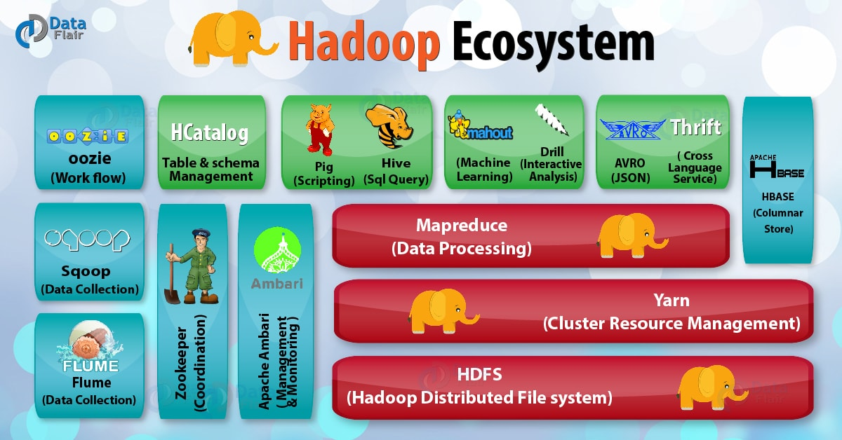

Slide 3
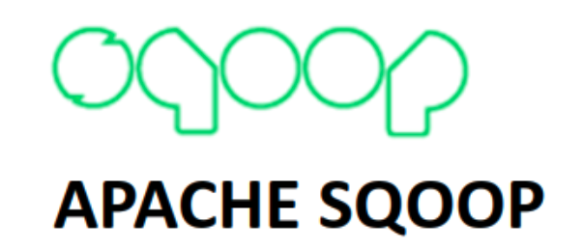
Apache Sqoop
Sqoop is a tool designed to transfer data between Hadoop and relational database servers.
It is used to import data from relational databases such as MySQL, Oracle to Hadoop HDFS, and export from Hadoop file system to relational databases

Slide 4
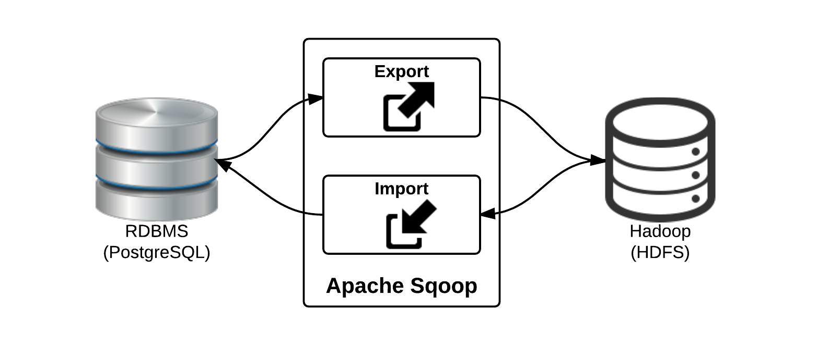
Apache Sqoop

Slide 5

Apache ZooKeeper
ZooKeeper is a centralized service for maintaining configuration information, naming and providing distributed synchronization services.

Slide 6
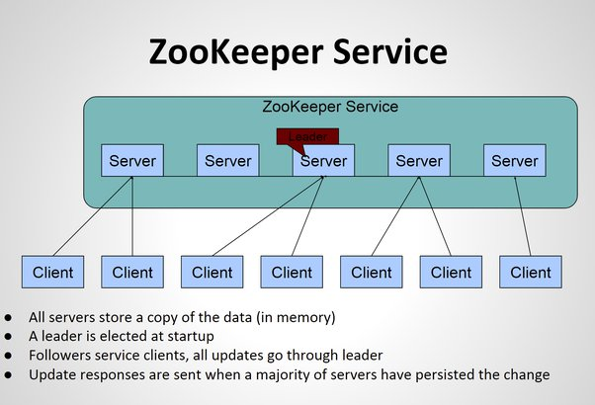

Slide 7
Apache Flume
Apache Flume is an open-source tool for collecting, aggregating, and moving huge amounts of streaming data from the external web servers to the central store, say HDFS, Hbase.
It is a highly available and reliable service which has tunable recovery mechanisms.
The main purpose of designing Apache Flume is to move streaming data generated by various applications to HDFS.

Slide 8
Why Apache Flume?
A company has millions of services that are running on multiple servers. Thus, produce lots of logs.
In order to process logs, a company requires an extensible, scalable, and reliable distributed data collection service.
In order to gain insights and understand customer behavior, they need to analyze these logs altogether.
Flume is a reliable, and highly available service for collecting, aggregating, and transferring huge amounts of logs into HDFS. It allows the collection of data collection in batch as well as in streaming mode.

Slide 9
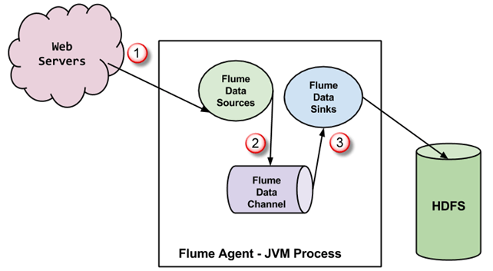
Apache Flume Architecture

Slide 10
Source
Begin
Txn
Channel
Event
Event
Event
Event
Event
Event
Transaction batch
Event
Event
Event
Event
Commit
Txn

Slide 11
Core Concepts: Event
An Event is the fundamental unit of data transported by Flume from its point of origination to its final destination. Event is a byte array payload accompanied by optional headers.
Payload is opaque to Flume
Headers are specified as an unordered collection of string key-value pairs, with keys being unique across the collection
Headers can be used for contextual routing

Slide 12
Core Concepts: Client
An entity that generates events and sends them to one or more Agents.
Example
Flume log4j Appender
Custom Client using Client SDK (org.apache.flume.api)

Slide 13
Core Concepts: Agent
A container for hosting Sources, Channels, Sinks and other components that enable the transportation of events from one place to another.
Fundamental part of a Flume flow
Provides Configuration, Life-Cycle Management, and Monitoring Support for hosted components

Slide 14
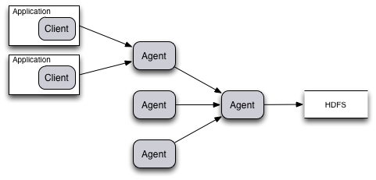
Typical Aggregation Flow
[Client]⁺ → Agent [→ Agent]* → Destination

Slide 15
Core Concepts: Source
An active component that receives events from a specialized location or mechanism and places it on one or more Channels.
Different Source types:
Specialized sources for integrating with well-known systems. Example: Syslog, Netcat
Auto-Generating Sources: Exec, SEQ
IPC sources for Agent-to-Agent communication: Avro
Require at least one channel to function

Slide 16
Core Concepts: Channel
A passive component that buffers the incoming events until they are drained by Sinks.
Different Channels offer different levels of persistence:
Memory Channel: volatile
File Channel: backed by implementation
JDBC Channel: backed by embedded Database
Channels are fully transactional
Provide weak ordering guarantees
Can work with any number of Sources and Sinks.

Slide 17
Core Concepts: Sink
An active component that removes events from a Channel and transmits them to their next hop destination.
Different types of Sinks:
Terminal sinks that deposit events to their final destination. For example: HDFS, HBase
Auto-Consuming sinks. For example: Null Sink
IPC sink for Agent-to-Agent communication: Avro
Require exactly one channel to function

Slide 18
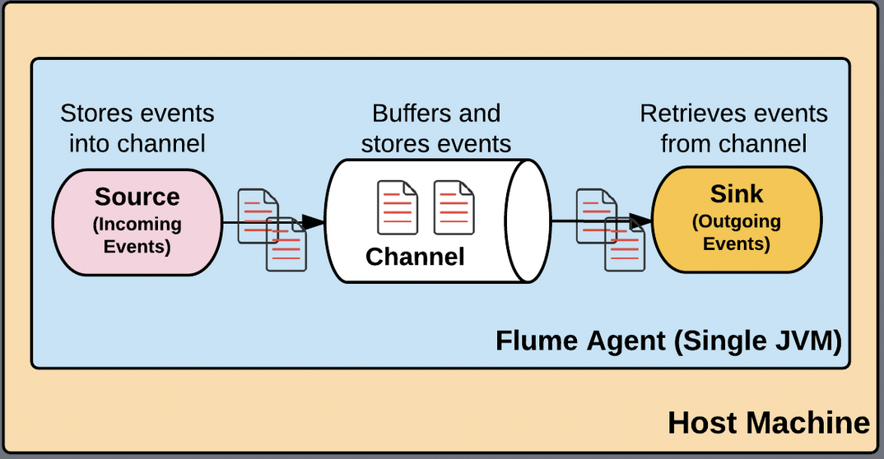

Slide 19
Flume Advantages
Apache Flume enables us to store streaming data into any of the centralized repositories (such as HBase, HDFS).
Flume provides steady data flow between producer and consumer during read/write operations.
Flume supports the feature of contextual routing.
Apache Flume guarantees reliable message delivery.
Flume is reliable, scalable, extensible, fault-tolerant, manageable, and customizable.

Slide 20
Flume Disadvantages
Apache Flume offers weaker ordering guarantees.
Apache Flume does not guarantee that the messages reaching are 100% unique.
It has complex topology and reconfiguration is challenging.
Apache Flume may suffer from scalability and reliability issues.

